Slide 1
News Classification

Slide 2
Objective:
In today’s world, data is power. With News companies having terabytes of data stored in servers, everyone is in the quest to discover insights that add value to the organization. With various examples to quote in which analytics is being used to drive actions, one that stands out is news article classification.
Nowadays on the Internet there are a lot of sources that generate immense amounts of daily news. In addition, the demand for information by users has been growing continuously, so it is crucial that the news is classified to allow users to access the information of interest quickly and effectively. This way, the machine learning model for automated news classification could be used to identify topics of untracked news and/or make individual suggestions based on the user’s prior interests.

Slide 3
Dataset:
The dataset is downloaded from Kaggle.
The dataset contains Train.csv and Test.csv files

Slide 4
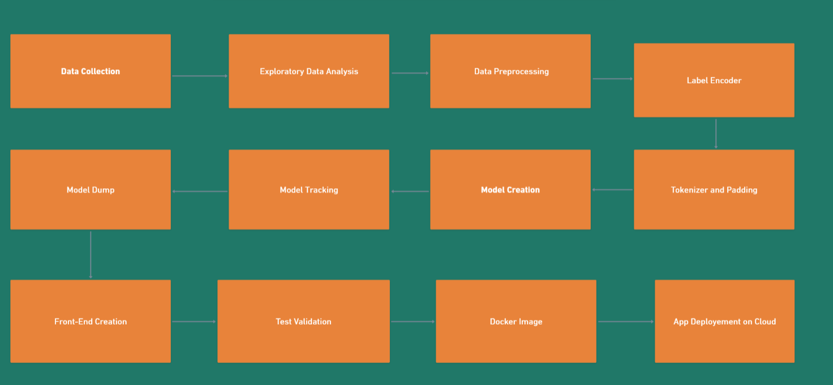
ARCHITECTURE

Slide 5
Data Validation and Data Transformation
Name Validation - Validation of files name as per the DSA.
Number of Columns - Validation of number of columns present in the files are 3 in Train dataset and 2 in Test dataset
Name of Columns - The name of the columns in validation and training are changed according to preference.
Data types of columns - The data types of columns is given in the schema file. It is validated when we insert the files into Database.
Null values in columns - If any of the columns in a file have the values as NULL or missing.

Slide 6
Data Preprocessing
Our data is not preprocessed and it contains a lot of punctuations and numbers. To convert raw data as a preprocessed format(like removing punctuations, numbers, single character, multiple spaces). We had created a function “preprocess_text”
After the raw text is preprocessing, we have to encode our labels to numerical encoding as they were categorically encoded before. For this we are using One-Hot Encoder and Label-Encoder

Slide 7
Model Training
In Model Training we have used different deep learning models.
First we had trained our Baseline model with 91% accuracy.
Now, after our baseline our goal is to beat the baseline model.
So, We had used more five models : Simple Dense Model, Conv1D, LSTM, GRU, Bidirectional LSTM

Slide 8
* From all these models, our Conv1D outperformed all the rest of the models with 96% accuracy.
Models | Accuracy | Precision | Recall | F1-Score
Baseline Model | 91.44385 | 0.936576 | 0.914439 | 0.918596
Simple Dense | 83.95722 | 0.857706 | 0.839572 | 0.843738
Conv1D | 96.25668 | 0.963797 | 0.962567 | 0.962662
LSTM | 85.5615 | 0.869636 | 0.855615 | 0.85179
GRU | 63.63636 | 0.684632 | 0.636364 | 0.645462
Bidirectional | 73.26203 | 0.732429 | 0.73262 | 0.73154

Slide 9
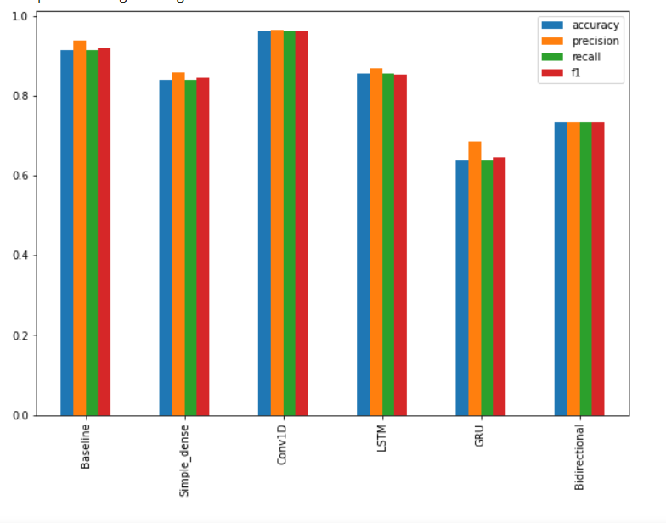
Model Results

Slide 10
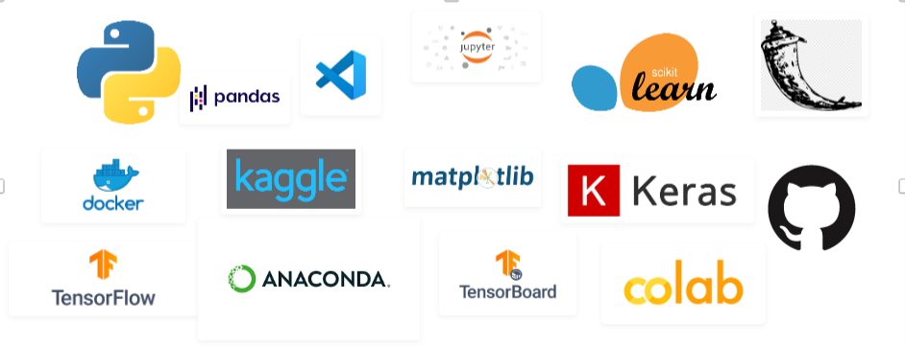
Tools Used

Slide 11
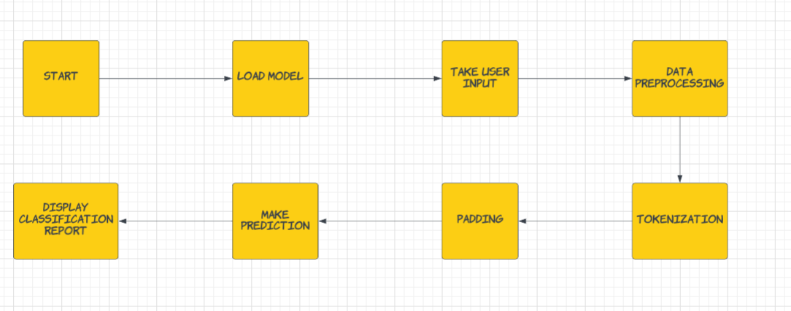
Deployment Process

Slide 12
Q&A
What’s the source of data?
The data for training is provided by the client.
2. What was the type of data?
The data was the combination of numerical and Categorical values.
3. What’s the complete flow you followed in this Project?
Refer slide 4th for better Understanding
4. After the File validation what you do with incompatible file or files which don’t pass the validation?
Files like these are moved to the Achieve Folder and a list of these files has been shared with the client and we removed the bad data folder.

Slide 13
5) How logs are managed?
We are using different logs as per the steps that we follow in
Validation and modelling like File Validation log, Model Training log, Prediction log etc.
6) What techniques were using for data pre-processing?
Removing unwanted attributes
Visualizing relation of independent variables with each other and output variables
Checking and changing Distribution of continuous values
Cleaning data and imputing if null values are present.
Converting Categorical data into numeric values.
Creating a new features according to preferences.

Slide 14
7) How training was done or what models were used?
After data preprocessing and feature engineering, the data is divided into training and validation.
Different algorithms are been used and in only Conv1D is performed the best and it is been used as final model.
8) How prediction was done?
The testing files are shared by the client. Then on the basis of model is loaded and perform prediction. In the end we get the accumulated data of predictions.
9) What are the different stages of deployment?
When the model is ready we build the app using Flask.
After, the app is build then for the deployment Cloud environment is used.

Slide 15
END

